Slide 1


Gregory Hinds
04/03/24

Slide 2

Outline
Executive Summary
Introduction
Methodology
Results
Conclusion
Appendix

Slide 3
Executive Summary
Summary of methodologies
Data Collection via API
Data Collection with Web Scraping
Data Wrangling
Exploratory Data Analysis with Data Visualization
Exploratory Data Analysis with SQL
Interactive Visual Analytics
Predictive Analytics
Summary of all results
Exploratory Data Analysis results
Interactive Analytics screen captures
Predictive Analytics results

Slide 4
Introduction
Project background and context
SpaceX advertises Falcon 9 rocket launches on its website with a cost of 62 million dollars; other providers cost upward of 165 million dollars each, much of the savings is because SpaceX can reuse the first stage. Therefore, if we can determine if the first stage will land, we can determine the cost of a launch. This information can be used if an alternate company wants to bid against SpaceX for a rocket launch. We endeavour to predict, using data science methodologies, if we can predict if the first stage booster will land successfully.
Problems you want to find answers
What factors determine if the rocket will land successfully?
The interaction amongst various features that determine the success rate of a successful landing.
What operating conditions needs to be in place to ensure a successful landing program.

Slide 5

Section 1

Slide 6
Methodology
Executive Summary
Data collection methodology:
We collected data using the publicly available SpaceX API and from the Wikipedia page listing launches.
Perform data wrangling
We checked for missing/incomplete data, engineered a feature to clearly identify successes and failures, and used one-hot encoding on categorical features.
Perform exploratory data analysis (EDA) using visualization and SQL
Perform interactive visual analytics using Folium and Plotly Dash
Perform predictive analysis using classification models
Using a train/test split of 80%/20%, we trained a logistic regression, a SVM and a Decision Tree classifier on the data.

Slide 7
Data Collection – Requests and SpaceX API
We want to collect data from an external API and transform it into a well-structured dataframe.
We collected data from the SpaceX API using the Python Requests package
Using the https://api.spacexdata.com/v4/launches/past endpoint
Using the Pandas json_normalize function we can extract data straight into a dataframe
As many data records were internal references, we also needed to perform extra calls to get the names and values associated with those internal references
We performed some filtering on this dataframe to show only Falcon 9 launches
We replaced some missing values in the PayloadMass column with the column mean

Slide 8
Data Collection – Requests and SpaceX API
Retrieve data from
…/v4/launches/past
requests
Present your data collection with SpaceX REST calls using key phrases and flowcharts
Normalize with pandas
pandas
Retrieve reference data from rockets
Retrieve reference data from payload
Retrieve reference data from launchpad
Retrieve reference data from cores
Replace missing values
Filter to Falcon 9 only
Notebook URL: https://github.com/Ysadore/SpaceX/blob/main/Data%20Collection%20API.ipynb

Slide 9
Data Collection - Scraping
Retrieve html data from Wikipedia
BeautifulSoup
We use the Python BeautifulSoup library to scrape structured data from contexts where the data is not formatted as we prefer
Extract the table headers
pandas
Create a dataframe with matching headers
Extract html body
Insert body data into dataframe
Notebook URL: https://github.com/Ysadore/SpaceX/blob/main/Data%20Collection%20with%20Web%20Scraping.ipynb

Slide 10
Data Wrangling
We performed exploratory data analysis and determined which labels we would use for model training later
We identified which columns had missing data
We counted the number of launches from each site, the number of successful launches and calculated the percentage success rate
We calculated the landing outcome per difference type of orbit
We categorized various landing outcomes into a single success/failure feature
Notebook URL: https://github.com/Ysadore/SpaceX/blob/main/Data%20Wrangling.ipynb

Slide 11
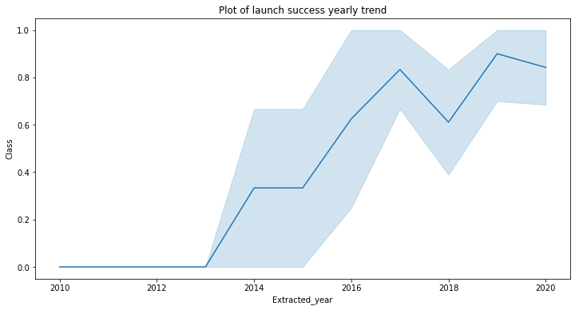
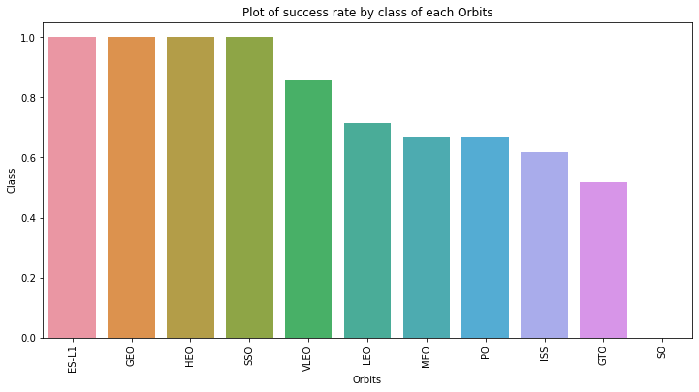
EDA with Data Visualization
We explored the relationship between Payload Mass, Flight Number (indicating progression over time), Orbit type and Success Rate
The success rate has mostly been increasing over time.
Some orbits have much lower success rates than others.
Notebook URL: https://github.com/Ysadore/SpaceX/blob/main/EDA%20with%20Data%20Visualization.ipynb

Slide 12
EDA with SQL
SQL queries performed:
Display the names of unique launch sites
Display 5 records where launch sites begin with the string 'CCA'
Display the total payload mass carried by boosters launched by NASA (CRS)
Display average payload mass carried by booster version F9 v1.1
List the date when the first succesful landing outcome in ground pad was acheived.
List the names of the boosters which have success in drone ship and have payload mass greater than 4000 but less than 6000
List the total number of successful and failure mission outcomes
List the names of the booster_versions which have carried the maximum payload mass. Use a subquery
List the records which will display the month names, failure landing_outcomes in drone ship ,booster versions, launch_site for the months in year 2015.
Rank the count of landing outcomes (such as Failure (drone ship) or Success (ground pad)) between the date 2010-06-04 and 2017-03-20, in descending order.
Notebook URL: https://github.com/Ysadore/SpaceX/blob/main/EDA%20with%20SQL.ipynb

Slide 13
Build an Interactive Map with Folium
We marked all launch sites, and added map objects such as markers, circles, lines to mark the success or failure of launches for each site on the folium map.
We mapped the feature launch outcomes to 0 for failure and 1 for success.
Using the color-labeled marker clusters, we identified which launch sites have relatively high success rate.
We calculated the distances between a launch site to its proximities and discovered some insights:
The launch sites are not near railways or highways, but are all close to the coast
The launch sites are all beyond a certain distance from cities
Notebook URL: https://github.com/Ysadore/SpaceX/blob/main/Interactive%20Visual%20Analytics%20with%20Folium.ipynb

Slide 14
Build a Dashboard with Plotly Dash
We built an interactive dashboard with Plotly dash
We plotted pie charts showing the total launches by a certain sites
We plotted scatter graph showing the relationship with Outcome and Payload Mass (Kg) for the different booster version.
Notebook URL: https://github.com/Ysadore/SpaceX/blob/main/app.py

Slide 15
Predictive Analysis (Classification)
We prepared the data with numpy, standardized/transformed it and split it into training and testing segments
We built different machine learning models and tune different hyperparameters using GridSearchCV.
We used accuracy as the metric for our model, improved the model using feature engineering and algorithm tuning.
Notebook URL: https://github.com/Ysadore/SpaceX/blob/main/Machine%20Learning%20Prediction.ipynb

Slide 16

Section 2

Slide 17
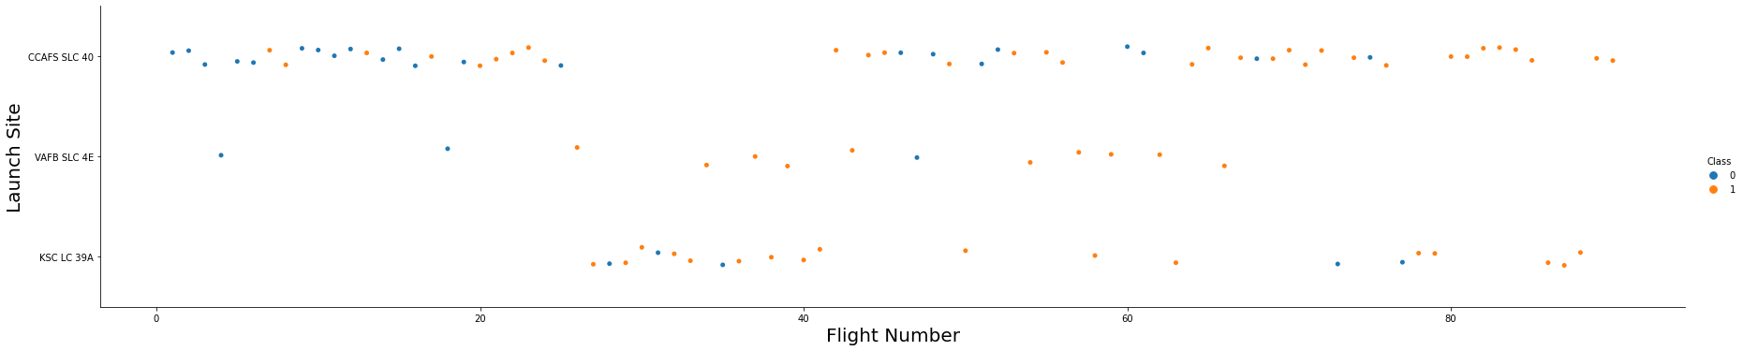
Flight Number vs. Launch Site
The more flights are launched from a site, the greater the success rate
Site KSC LC 39A started launches later than the others
Site VAFB SLC 4E is launched from less frequently than the others

Slide 18
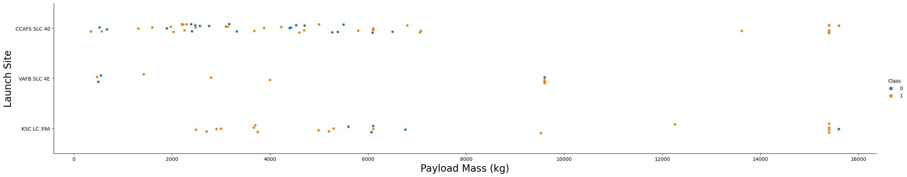
Payload vs. Launch Site
Most launches have a payload of <8000kg
KSC LC 39A has a very high success rate for low-mass payloads
CCAFS and KSC has a very high success rate for very heavy payloads

Slide 19

Success Rate vs. Orbit Type
Some orbits have a much higher or flawless success rate: ES-L1, GEO, HEO and SSO
Whereas launches to the ISS and into GTO are much less likely to succeed

Slide 20
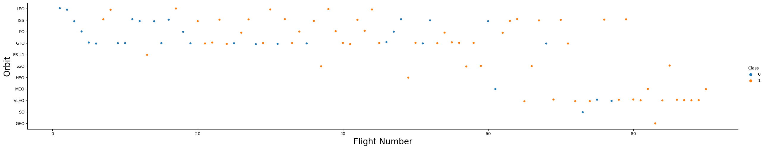
Flight Number vs. Orbit Type
LEO launches are getting more reliable over time
Some orbits are less frequent than others – MEO and GEO are particularly infrequent

Slide 21
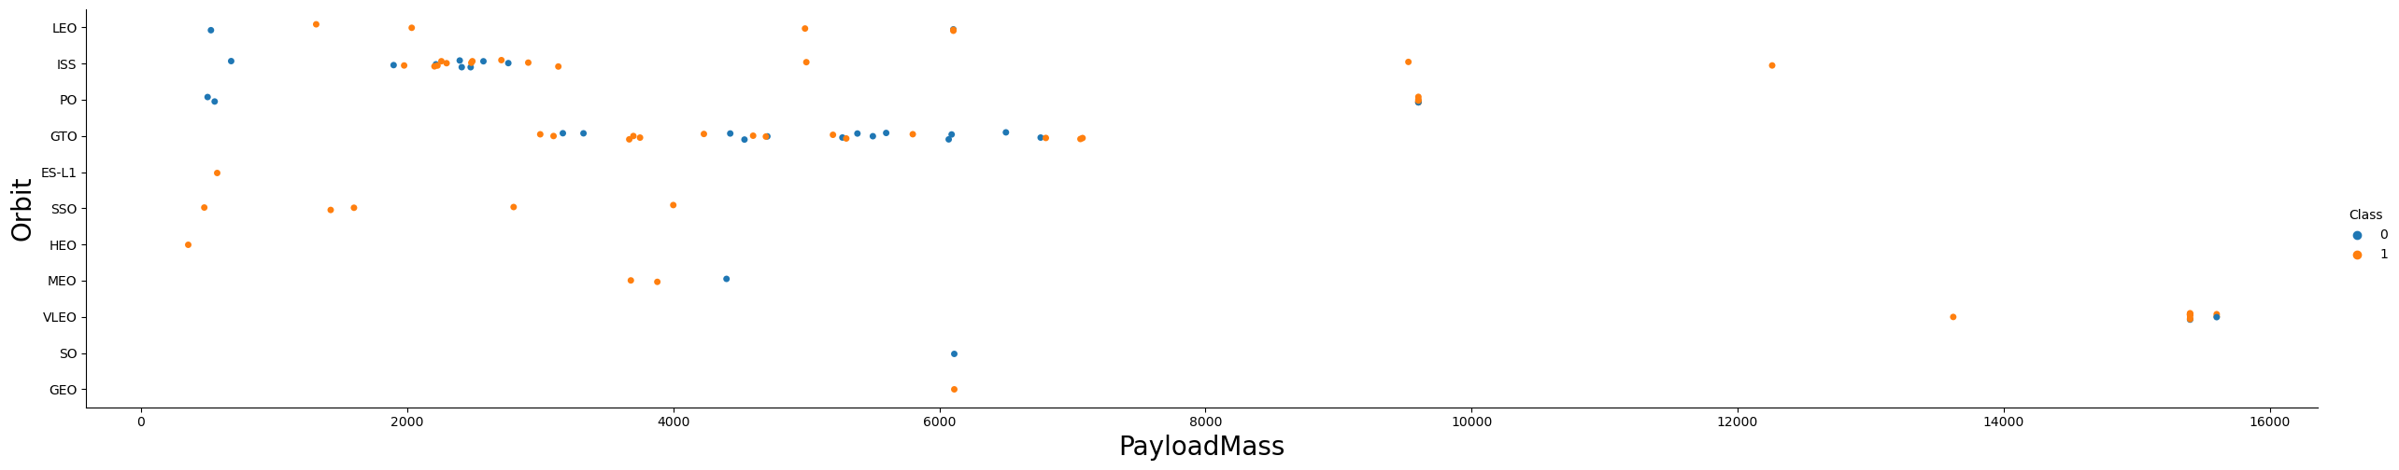
Payload vs. Orbit Type
VLEO has a tendency towards very heavy payloads
There isn’t a clear relationship between payload mass and success for GTO

Slide 22
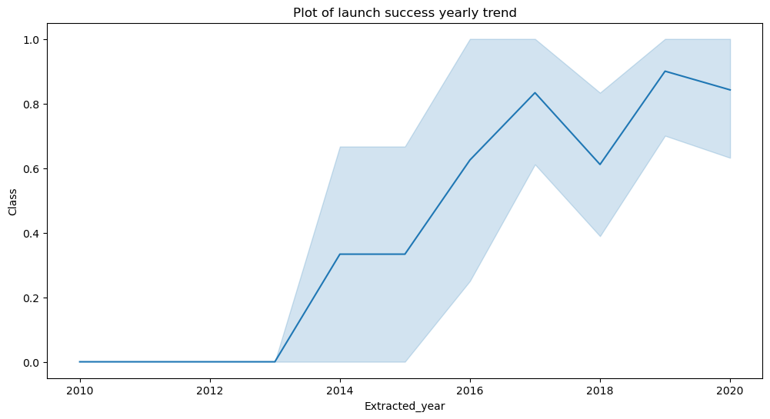
Launch Success Yearly Trend
Success rate has been broadly increasing until 2017 before a dip in 2018
Launch success rate in 2020 is around 80%

Slide 23
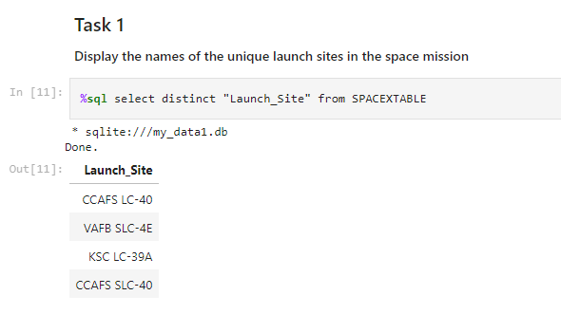
All Launch Site Names
The DISTINCT keyword allows us to select only unique values

Slide 24
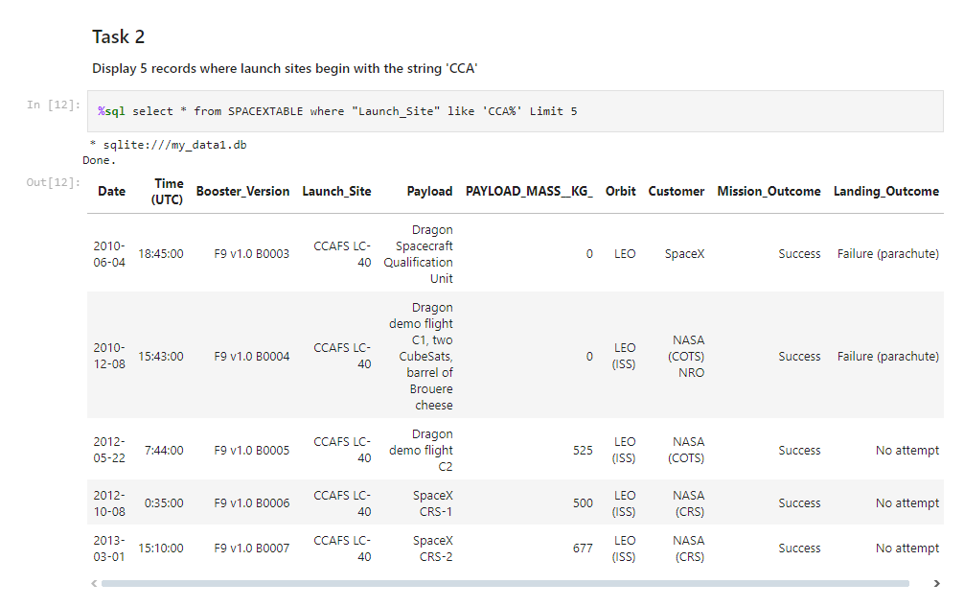
Launch Site Names Begin with 'CCA'
The LIMIT keywords selects only that many rows
The % symbol in the LIKE clause acts as a wildcard for any number of characters

Slide 25
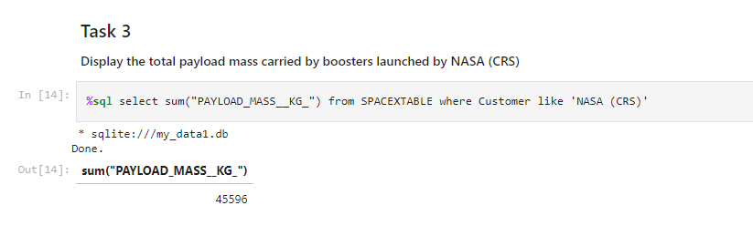
Total Payload Mass
SUM is an aggregate function, returning a single value calculated from all the values in the column

Slide 26
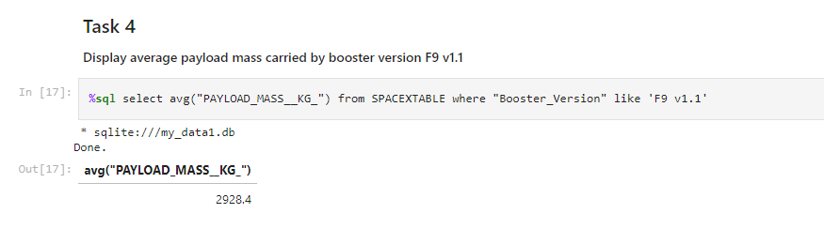
Average Payload Mass by F9 v1.1
AVG is also an aggregate function, performing the arithmetic mean

Slide 27
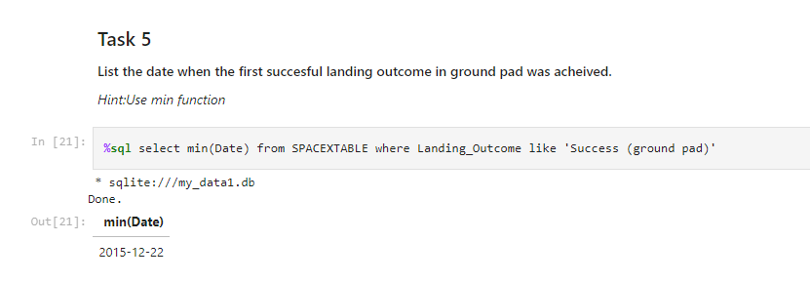
First Successful Ground Landing Date
MIN works on numbers and dates

Slide 28
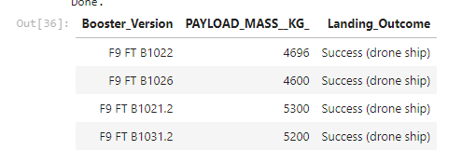
Successful Drone Ship Landing with Payload between 4000 and 6000
select distinct "Booster_Version", PAYLOAD_MASS__KG_, Landing_Outcome from SPACEXTABLE where Landing_Outcome like 'Success (drone ship)' and PAYLOAD_MASS__KG_ < 6000 and PAYLOAD_MASS__KG_ > 4000
We can use Boolean operators like AND, OR, NOT and so forth to join and modify WHERE clause items

Slide 29
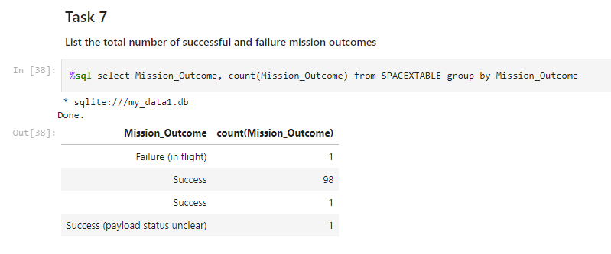
Total Number of Successful and Failure Mission Outcomes
We can combine aggregate functions and the GROUP BY keyword to perform the aggregation only over unique values from another column

Slide 30
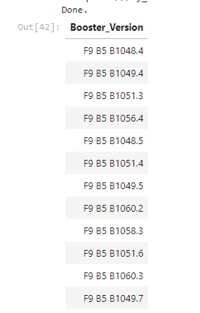
Boosters Carried Maximum Payload
select distinct booster_version from SPACEXTABLE where PAYLOAD_MASS__KG_ = (select max(PAYLOAD_MASS__KG_) from SPACEXTABLE)
This query uses a subquery to pre-calculate another value; in this case the mass of the heaviest payload

Slide 31
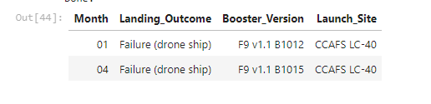
2015 Launch Records
select substr(Date, 6,2) as Month, Landing_Outcome, Booster_Version, Launch_Site from SPACEXTABLE where substr(Date,0,5)='2015' and Landing_Outcome = 'Failure (drone ship)'
We needed to use substr to handle date comprehension here as this implementation SQL lacks native functions

Slide 32
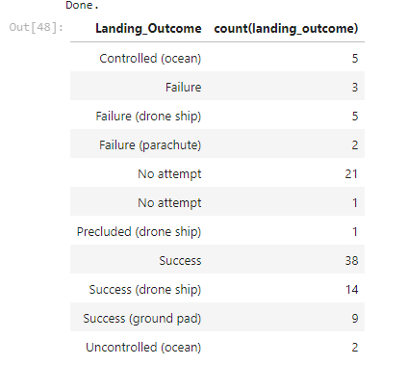
Rank Landing Outcomes Between 2010-06-04 and 2017-03-20
select landing_outcome, count(landing_outcome) from SPACEXTABLE group by landing_outcome where "date" > 2010-06-04 and "date" < 2017-03-20
The ORDER BY … DESC keyword would be used to order the results

Slide 33

Section 3

Slide 34

Launch Sites Global Map

Slide 35

Markers showing Launch Sites

Slide 36

Launch Site proximity to landmarks

Slide 37

Section 4

Slide 38

Success Rate by Launch Site

Slide 39

Success Ratio of the most successful Launch Site

Slide 40

Payload Mass and Launch Outcome variants

Slide 41

Section 5

Slide 42

Classification Accuracy
We are seeking the model with the best model accuracy.
In this case it was a Decision Tree

Slide 43

Confusion Matrix
This is the Confusion Matrix for the Decision Tree model
The model is highly accurate for Successful Landings, but significantly less so for Unsuccessful Landings

Slide 44
Conclusions
We can conclude that:
The larger the flight amount at a launch site, the greater the success rate at a launch site.
Launch success rate has increased steadily between 2013 and 2020.
Launches to ES-L1, GEO, HEO, SSO, VLEO orbits had the highest success rates.
KSC LC-39A had the most successful launches of any sites.
The Decision Tree classifier is the best machine learning algorithm for this task.

Slide 45


